Slide 1
NLP & MLOPS SYSTEM DESIGN
Automated Resume-JD Matcher
Multi-Stage Semantic Architecture & Explainable Skill-Gap Analysis System

Slide 2
01 / PROBLEM & BOUNDARIES
Problem Statement & System Scope
Out of Scope Guardrails
In Scope Capabilities
Zero Auto-Rejection: Human recruiter review mandatory.
Semantic Matching: Dense Resume-JD similarity scoring.
Demographic Blindness: Strips age, gender, and name PII.
Fit Classification: Low, Moderate, and High tiers.
Skill Extraction: Matched versus missing skill lists.
Standalone Deployment: Decoupled from legacy ATS databases.
Batch Ranking: Real-time candidate pool ordering.
No Black-Box Scoring: Every prediction includes skill evidence.

Slide 3
02 / DATA ENGINEERING
Dataset & Text Preparation
1. Regex & HTML Sanitization
Strips markup tags and normalizes whitespace.
Hugging Face Corpus
facehuggerapoorv/resume-jd-match
2. Demographic PII Scrubbing
70 / 15 / 15
Removes candidate names, pronouns, and graduation years.
Stratified Train, Validation, and Test Splits
3. Quality & Balance Validation
Audits token lengths and enforces balanced labels.

Slide 4
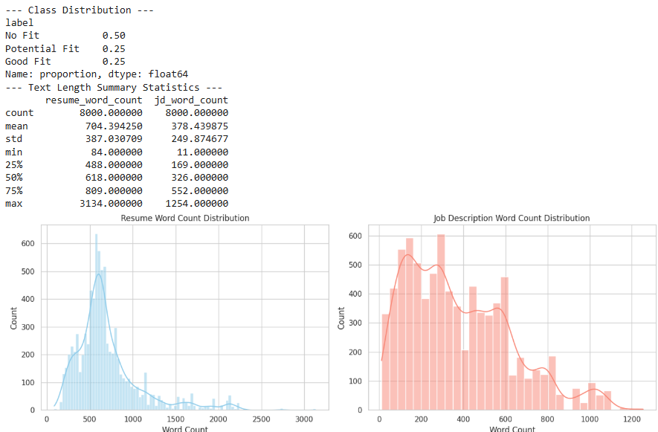

Slide 5
SYSTEM ARCHITECTURE DEEP-DIVE
Four-Stage Modeling Pipeline
Combining rapid lexical baselines, dense bi-encoders, neural feature fusion, and cross-encoder reranking.

Slide 6
03 / ARCHITECTURE BLUEPRINT
Multi-Stage Pipeline Overview
1
2
3
4
STAGE 01
STAGE 02
STAGE 03
STAGE 04
Baseline TF-IDF Cosine
Dense Bi-Encoder (SBERT)
Feature Fusion & Classification
(Deep Neural Network / TensorFlow)
Explainable Skill Gap Engine
Similarity Pipeline.
384-dim dense semantic vectors.
(NER + Embedding Keyword Cosine Distance)
Cosine Sim + Concatenated Embeddings -> Fit Class & Probability

Slide 7
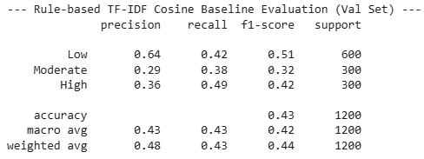
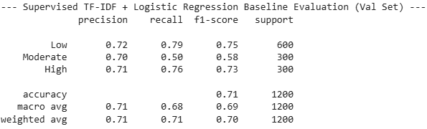
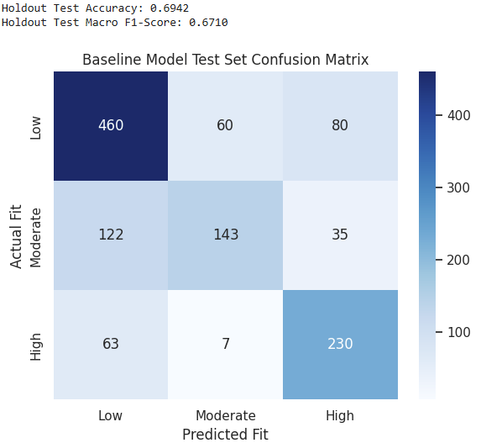
04 / REPRESENTATION LEARNING
Stage 1: Lexical
STAGE 1 • LEXICAL BASELINE
TF-IDF + Cosine Similarity
Exact keyword overlap misses domain synonyms.

Slide 8
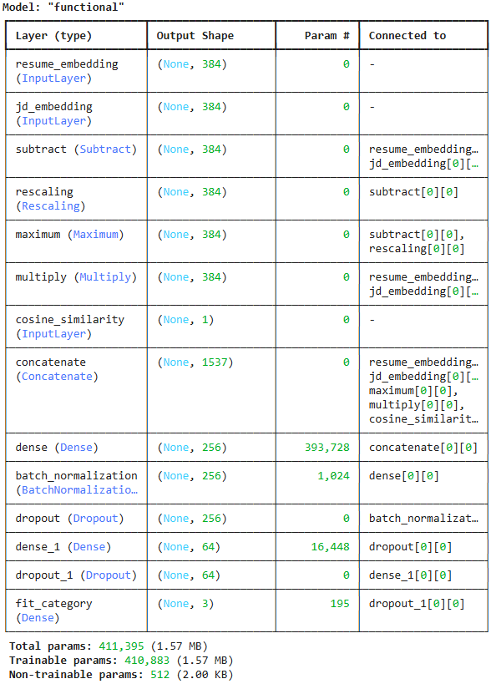
04 / REPRESENTATION LEARNING
Stage 2: Semantic
STAGE 2 • SIAMESE BI-ENCODER
Sentence-BERT Embeddings
Dense vectors capture conceptual skill equivalence.
all-MiniLM-L6-v2 (384-d) • Pre-cacheable

Slide 9
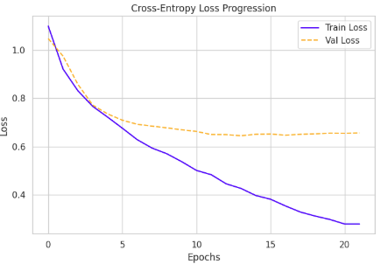
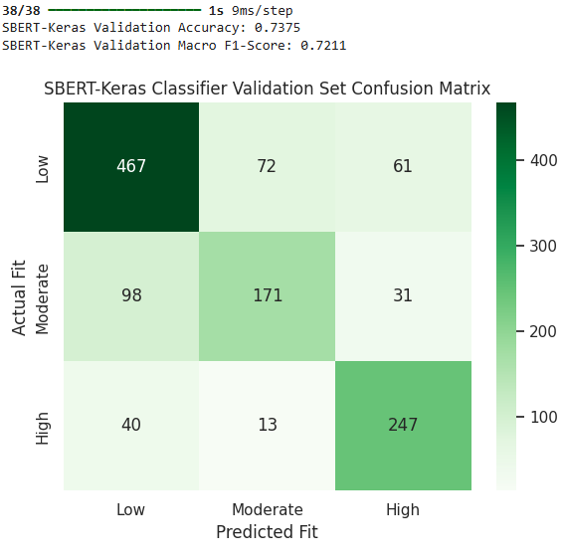
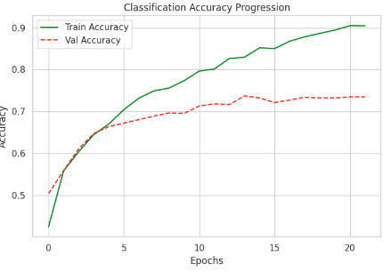

Slide 10
06 / HYBRID PRODUCTION ENGINE
Stage 4: Two-Stage Reranking
10,000
STAGE 1 RETRIEVAL
STAGE 2 RERANKER
Top-20
Top-5
Candidate Pool
Pre-indexed vectors
SBERT cosine filter (14 ms)
Cross-attention score (35 ms)

Slide 11
Run the application
Train model pipeline
  Data Ingestion, Data Cleanliness & Missing Value Inspection
  Run Baseline Model (TF-IDF + Cosine Similarity), Supervised Baseline Classifier (Logistic Regression on Vector Differences), Dense Semantic Bi-Encoder (Sentence-BERT)
Run the FastAPI server for Processing and Ranking Candidates
  Run the Google colab file for FASTAPI service which has GPU access
  upload the models in artifacts and app.py in app folder
  Run the server
Run the UI for passing Job Description and Candidate Resumes
  docker build -f Dockerfile.streamlit -t resume-matcher-ui:v1 .
  docker run -d --name resume-matcher-ui -p 8501:8501 --add-host=host.docker.internal:host-gateway –e API_BASE_URL="http://host.docker.internal:8000" resume-matcher-ui:v1
  Link the running FastAPI server link to StreamLit UI

